Slide 1
Data Warehouse Development for Models Sales Company
Client: Models Sales Company Current System: OLTP (MS SQL Server) Identified Need: Centralised access for sales data analysis Our Goal: Design and implement a complete OLAP solution Team Role: OLAP design, ETL development, data validation, reporting
Prepared by: Brandon Nguyen & Natara Iata Pimoe
Notes:
Introduction:
The case study is based on a fictional company called Models Sales Company, which currently uses an OLTP system in MS SQL Server to store transactional data for their customers, products, and sales.
In the scenario, the Sales Department Manager wants to move from basic storage to centralised, analysis-ready data access. The goal is to support better decision-making through detailed reporting and analysis.
As a group, we were tasked with designing and implementing a complete data warehouse solution. This included designing a Star Schema, applying ETL processes, enforcing data quality rules, and generating all required monthly and summary reports.
Each of us contributed to different aspects such as schema design, data cleansing, SQL scripting, and validating business logic. Together, we built a solution that supports clean, consistent, and high-performing data analysis.

Slide 2
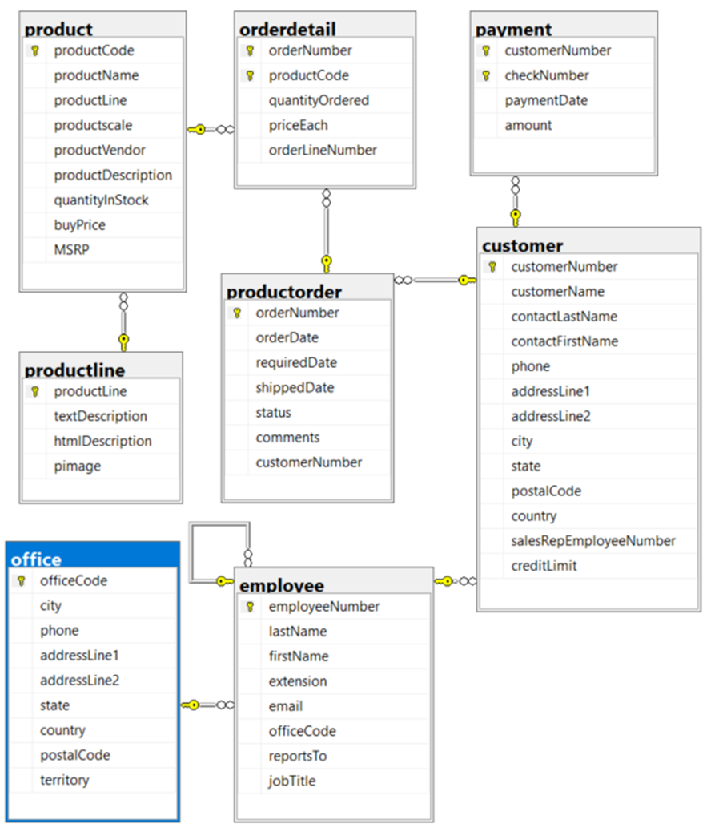
OLTP Schema

Slide 3
Report requirements
1. Monthly report on the most profitable employees
2. Summary report on the total sales based on City.
3. Monthly report on the customers who have bought the most.
4. Monthly sales report that list and comparer of Total-Profit with Total-Possible-Profit for each product line

Slide 4
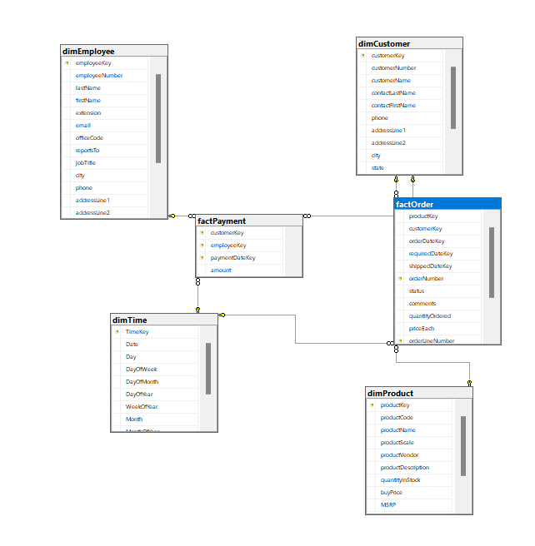
Constellation Schema
Why constellation ?
Handles Complex Reporting
Shared Dimensions
Advanced Analysis
Easy Maintenance
Star
One Fact Tables
Dimension Tables
Low Flexibility
Best for simple analysis
VS
Constellation
Multiple Fact Tables
Shared Dimension Tables
Suitable for Our Project
Best for complex analysis with multiple facts
Figure 1
Notes:
We chose the constellation schema because it fits our project’s needs better than a star schema.
First, it handles complex reporting. Our reports require analysing data from multiple areas like profits, top employees, cities, and customers on a monthly basis. Using multiple fact tables makes this much easier.
Next, it uses shared dimensions, like customers and products, which are connected to both sales and payments. This reduces duplication – we only store each customer’s info once, even though it’s used in multiple places.
It also supports advanced analysis. For example, we can compare data across fact tables, like checking if employees who process high payments also generate high product sales.
It’s easier to maintain. If customer or product information changes, we only update it in one place, and that change is automatically reflected in all the reports and queries that use it.
So overall, the constellation schema gives us the flexibility, performance, and simplicity we need for a reliable data warehouse solution.
________________________________________________________________________________________________________________________________________________
Comparison to Star Schema:
We've compared the star schema with the constellation schema to explain why we chose the constellation design for our data warehouse.
The star schema uses just one central fact table and several dimension tables that are not shared. It’s a simpler design and works well for basic reporting. However, in our case, we have multiple types of data to analyse, like sales and payments, which come from different sources and need to be stored in separate fact tables.
That’s where the constellation schema becomes a better option.
It allows us to have multiple fact tables, such as factOrder and factPayment, while still using shared dimension tables like customers, products, and employees. This makes it much more flexible and suitable for complex reporting.
Also, the constellation schema reduces repetition. For example, customer info is stored once in the dimCustomer table, but it’s connected to both sales and payments data. This makes maintenance easier and keeps our data cleaner.
So, for our project, the star schema wasn’t suitable because it couldn’t handle all the complexity we needed. The constellation schema is a much better fit because it supports advanced analysis and meets the needs of our business scenario.
Figure 1 was retrieved from our SSMS Project

Slide 5
Constellation Schema

Slide 6
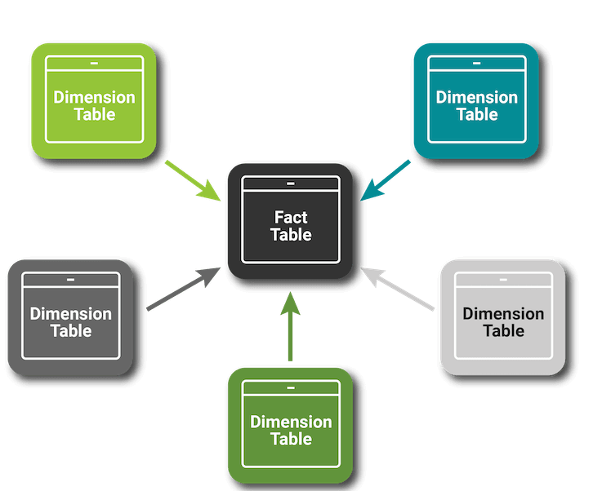
Populating Data DQLog & DW - Tables
1
Create and import the data source named: sales_AU_NZ
2
Create the DW and named : DW_sales_AU_NZ
Figure 2
3
Create DQ log table and dim tables in DW_sales_AU_NZ
Dimension Tables were chosen based on the reporting needs:
1. dimCustomer: for customer-based reports. | 2. DimEmployee: to track employee performance
3. dimProduct: to calculate sales and profit by product/category. | 4. DimTime: always included for time-based analysis (e.g. monthly reports)
4
Create factOrder table and factPayment in DW_sales_AU_NZ.
factOrder: uses orderNumber + orderLineNumber
factPayment: uses customerKey + paymentDateKey + employeeKey + checkNumber
Notes:
First, we imported the source data into a database called sales_AU_NZ.
Then, we created our data warehouse and named it DW_sales_AU_NZ.
Inside the data warehouse, we created a DQLog table to track any data quality issues based on the rules we defined earlier.
Next, we set up our dimension tables based on the reporting requirements:
dimCustomer is used for customer-based reports.
dimEmployee helps us analyse employee performance.
dimProduct allows us to calculate profit and sales by product and category.
And dimTime is always included so we can generate time-based reports like monthly or yearly summaries.
After the dimension tables, we created two fact tables:
factOrder, which uses a composite key of orderNumber and productKey to track each product sold in each order.
factPayment, which uses a composite key of customerKey, paymentDateKey, and employeeKey to uniquely track each payment transaction.
This structure supports all our business analysis and reporting needs efficiently.
Figure 2 retrieved from: https://www.matillion.com/blog/top-10-tips-for-creating-dimension-tables-using-matillion

Slide 7
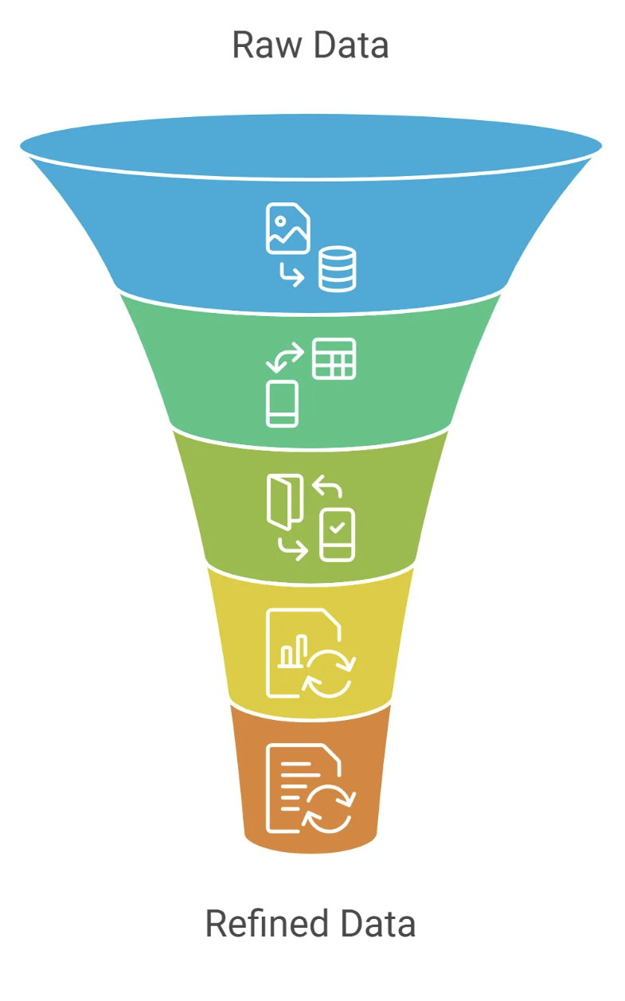
Populating Data DQLog & DW - Merging
Step
DQ Rules scan and log invalid records into DQLog using %%physloc%%
Merge Clean Data – Import only records not found in DQLog table
by
3. Fix Valid Records – Use a second merge to update/insert records with Action = 'fix'
4. Repeat for all dimension and fact tables
Step
Ensures only clean, valid data enters the data warehouse
Figure 3
Figure 3
Notes:
To populate our data warehouse, we followed a structured merge process using the DQ Log to ensure high data quality.
First, we used SQL rules to check all the source data and log any bad records into a DQLog table. Each record was tracked using %%physloc%%, which lets us find the exact row that failed.
Then, we used MERGE statements to bring clean data from sales_AU_NZ into DW_sales_AU_NZ. In the first merge, we only imported records not in the DQ log with action 'reject' these are already clean.
After that, we ran a second merge for records that were flagged to fix, such as changing country names to standard codes like 'AU' or 'NZ', or adjusting negative values like buyPrice.
This two-step approach was applied across all dimension and fact tables, including dimCustomer, dimEmployee, dimProduct, factOrder, and factPayment.
By doing it this way, we filtered out bad data, fixed what we could, and ensured that only accurate, clean records were stored in our OLAP database.
Figure 3 was retrieved from: https://www.upgrad.com/blog/methods-of-data-transformation-in-data-mining/

Slide 8
Data Quality – Rule 1 to 5
Rule No.
Description
Action (If-Then)
1
buyPrice in Products
Reject if 0 or NULL; Fix negative →convert to positive
2
priceEach in OrderDetails​
Reject if 0 or NULL; Fix negative →convert to positive​
3
quantityOrdered in OrderDetails​
Reject if 0 or NULL; Fix negative →convert to positive
4
MSRP in Products​
Reject if MSRP is less than buyPrice​
5
quantityInStock in Products
Reject if NULL or less than 0
Notes:
We’re showing the first five data quality rules that we’ve applied as part of the data validation process.
Rule 1 to 3 are about making sure the numeric fields like buyPrice, priceEach, and quantityOrdered have valid values. So if any of these are missing, zero, or even negative, they either get fixed or rejected depending on the case. This helps prevent invalid transactions from entering the system.
Rule 4 makes sure that the MSRP – which is the Manufacturer’s Suggested Retail Price – is never lower than the buyPrice, because selling below cost could result in a loss.
Rule 5 makes sure that quantityInStock values are valid – we reject any entries where stock is missing or negative. This prevents inventory-related errors in the system.

Slide 9
Data Quality – Rule 6 to 10
Rule No.
Description
Action (If-Then)
6
productCode in OrderDetails
Reject if NULL or does not exist
7
customerNumber, addressLine, city in Customers
Reject if customerNumber is NULL or doesn't exist and if any of the address fields are NULL
8
requiredDate, shippedDate in Orders
Reject if orderDate > required/shipped; Fix NULLs → required = orderDate + 7, shipped = +2
9
amount in Payment
Reject if NULL or less than 0
10
Country in Customers & Offices​
Fix inconsistent formatting to standard→ "USA" (e.g. US, UNITED STATES → USA)
Notes:
Here we have the remaining five validation rules.
Rule 6 checks that all productCodes in the Order Details actually exist. If a product code is missing or invalid, we reject that entry, since it can’t be linked to the product catalog.
Rule 7 checks that customer records are complete. If the customerNumber is missing or doesn’t exist and at the same time, if address details like addressLine1, addressLine2, or city are missing then the record is rejected. This helps avoid issues in customer communication and delivery.
Rule 8 focuses on order dates. If the order date is later than the required date or shipped date, that’s flagged as invalid. And if the required or shipped dates are missing, we apply a fix – for example, setting the required date to 7 days after the order date.
Rule 9 ensures that all payments have a valid amount – they can’t be missing or negative.
Rule 10 is about standardising country names. We’ve cleaned up inconsistencies in the data, for example converting “US”, “United States” or even “UNITED STATES” into one standard format, which is ‘USA’. This helps keep reporting consistent, especially when filtering by region.

Slide 10
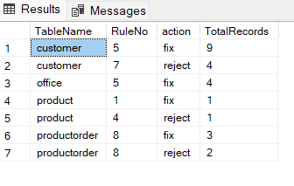
Data Quality - Summary
E
Extract
Collected data from operational systems
T
Transform
Applied 10 business rules
Fixed or rejected invalid records
Standardised values (e.g. country format, dates)
L
Load
Loaded only clean, validated data into the warehouse
Notes:
To wrap it up, during the Transform stage of the ETL process, we applied 10 key validation rules to ensure the data going into the system was accurate, consistent, and complete.
We checked values like prices, quantities, dates, country formats, and even customer and product references. When possible, we fixed the issues - for example, converting negative numbers to positive, or setting default dates. If a record couldn’t be corrected, we rejected it to prevent bad data from entering the warehouse.
This step is crucial in ETL because it protects the quality of the final data. As a result, the business now has cleaner, more reliable data for decision-making, reporting, and analysis
Figure 4 retrieved from: https://reqtest.com/en/knowledgebase/etl-testing-or-data-warehouse-testing/

Slide 11
Questions?
Notes:
The case study is based on a fictional company called Models Sales Company, which currently uses an OLTP system in MS SQL Server to store transactional data for their customers, products, and sales.
In the scenario, the Sales Department Manager wants to move from basic storage to centralised, analysis-ready data access. The goal is to support better decision-making through detailed reporting and analysis.
As a group, we were tasked with designing and implementing a complete data warehouse solution. This included designing a Star Schema, applying ETL processes, enforcing data quality rules, and generating all required monthly and summary reports.
Each of us contributed to different aspects such as schema design, data cleansing, SQL scripting, and validating business logic. Together, we built a solution that supports clean, consistent, and high-performing data analysis.

